Slide 1
Vancouver Parking Meters Data Analysis
Presented by: Owen and Bradley
Notes:
(Owen)

Slide 2
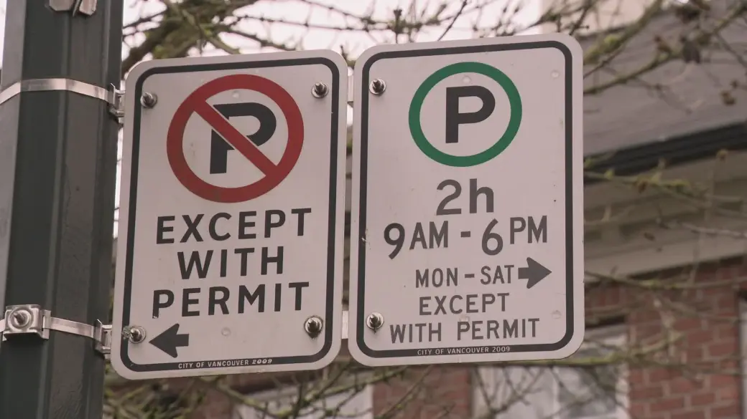
Parking Meter Data
Shows the Meterheads of the parking (example: twin, pay station)
Parking limit restriction
Meter in effect
Cost per hour
Location within vancouver (example: downtown, Kerrisdale)
https://i1.wp.com/media.globalnews.ca/videostatic/news/zdq9fhzss2-lg1hm4w984/NH_CITYWIDE_PARKING.jpg?w=1040&quality=70&strip=all
Notes:
(Owen)
https://opendata.vancouver.ca/explore/dataset/parking-meters/table/
The parking meter data is from the open data vancouver website. The data had many useful information in the excel sheet, the meterheads will tell you on the method of which where you could pay for parking, they have parking limit restriction and cost per hour dependent on time on when the customer parks their car. Also it had where the location of where each meterhead was by coordinate and neighbourhood.

Slide 3
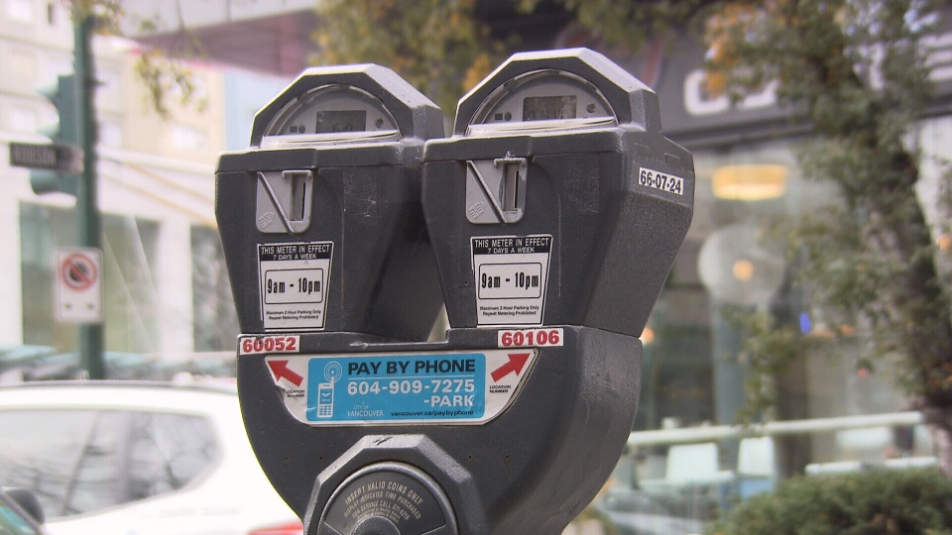
Why would we want to use this data?
Administrators could look at the data and see their projections of revenue each neighbourhood
Customers could see the going rate for parking in the city
Show how many parking spots are in the neighbourhood/ city
Show what kinds of meters are around the city and see if they are accessible for handicap, motorcycles
https://www.ctvnews.ca/polopoly_fs/1.1685487.1392334211!/httpImage/image.jpg_gen/derivatives/landscape_960/image.jpg
Notes:
(Owen)
Why would we want to use this data
If you were a customer, you would want to use the data to tell how much that you would be paying for parking per hour and weather you are getting a great deal for parking. Shows that if you are travelling to vancouver and you need a handicap parking spot that you may need to have some research before you go, as it may be difficult to find spots that accommodate disabilities.
If you were an administrator working for the city of vancouver you could use the data to show the potential earnings that you could be making per day, month or year. You may want statistics of how much you are changing people per hour in vancouver or if you need to the parking limits, as you may want to increase or decrease the limit by demand.

Slide 4
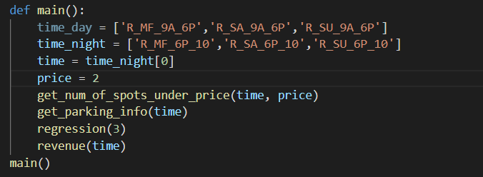
Function main()
Notes:
(Bradley)
Function main()
Here are all the functions,
Time_day and time_night = are the specific time that can be pass. Weekdays, saturday and sunday 9am - 6 pm. And the same days from 6pm - 10 pm
Time is the selected time you selected
price is the price that you are willing to pay an hour
get _num_spots_under_price(time, price) - means that it will return a graph of how many spots where you can park at the designated time under the specific price
get_parking_info(time) - will tell the mean, median, min, max, std and the number of spots in the neighbourhood at that given time
regression - parameters is the time limit that you need to stay, and it will return the prediction of how much you will be spending an hour to park
Revenue - will tell you how much the city could potentially make if every parking spot was full for the day

Slide 5
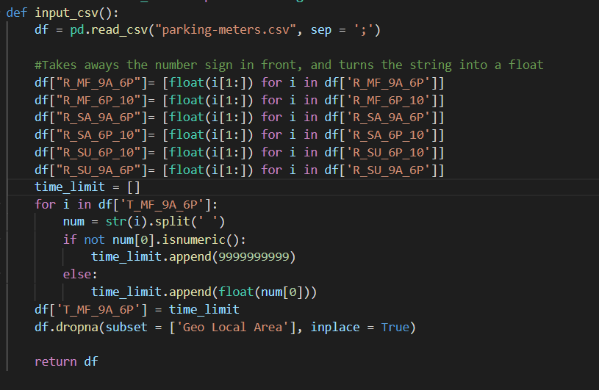
Data Cleaning
Notes:
(Bradley)
We had to change all of the cost to float numbers because they all had number signs in front of them
Time limits were not float numbers as they had hr after the value or no time limit, so if they had no time limit it would put a bunch of 9’s for the limit or else it got rid of the hr and made the value a float.
We dropped all the values if the geo local area was not a number.

Slide 6
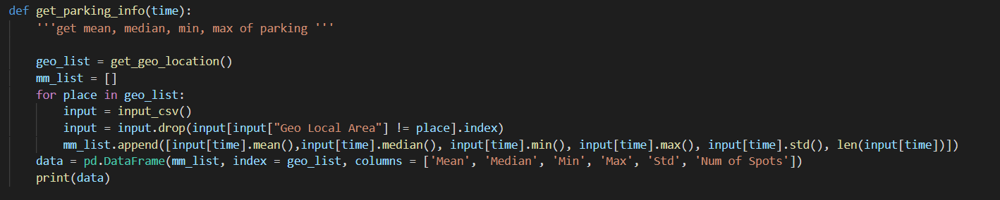
Getting Information of Parking by Neighbourhood
Notes:
(Bradley)
Here we have a function get_parking_info, where it will take the time that you want to park and will return the mean, median, min,max, standard deviation and number of spots there are in the neighbourhood.
Importing the csv file it will go through all of the locations and create a dataframe of all the information.

Slide 7
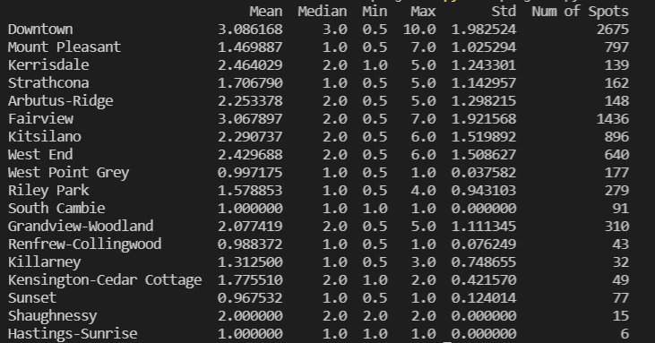
Parking Weekday Rates from 9AM - 6PM
Notes:
(Owen)
From the function get_parking_info you can see the displayed information in a matrix. You can see that downtown and fairview are have the highest mean and downtown with the highest median and max.

Slide 8
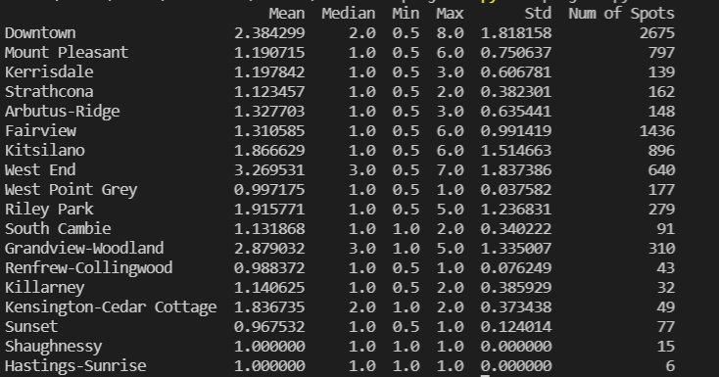
Parking Weekday Rates from 6PM - 10PM
Notes:
(Owen)
Here is a screenshot of the same function get parking info, but we have changed it to the weekday parking from 6pm to 10 pm

Slide 9
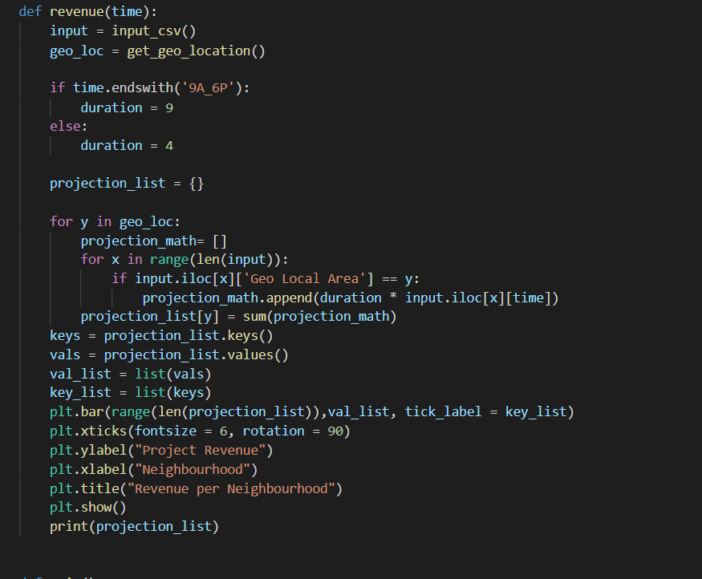
Revenue function()
Notes:
(Bradley)
With the revenue function, we are checking in the time period, what is the max that each neighbourhood could make in the given time.
Using the time variable, we check what it ends with so we get the duration of time
In the for loop, we are checking the each neighbourhood, and when it equals that specific location, we would get the cost it is to park per hour then multiple by the duration
We ignore the time limit because we want the high potential, so we assume once someone limit is up we get another car right away parking

Slide 10
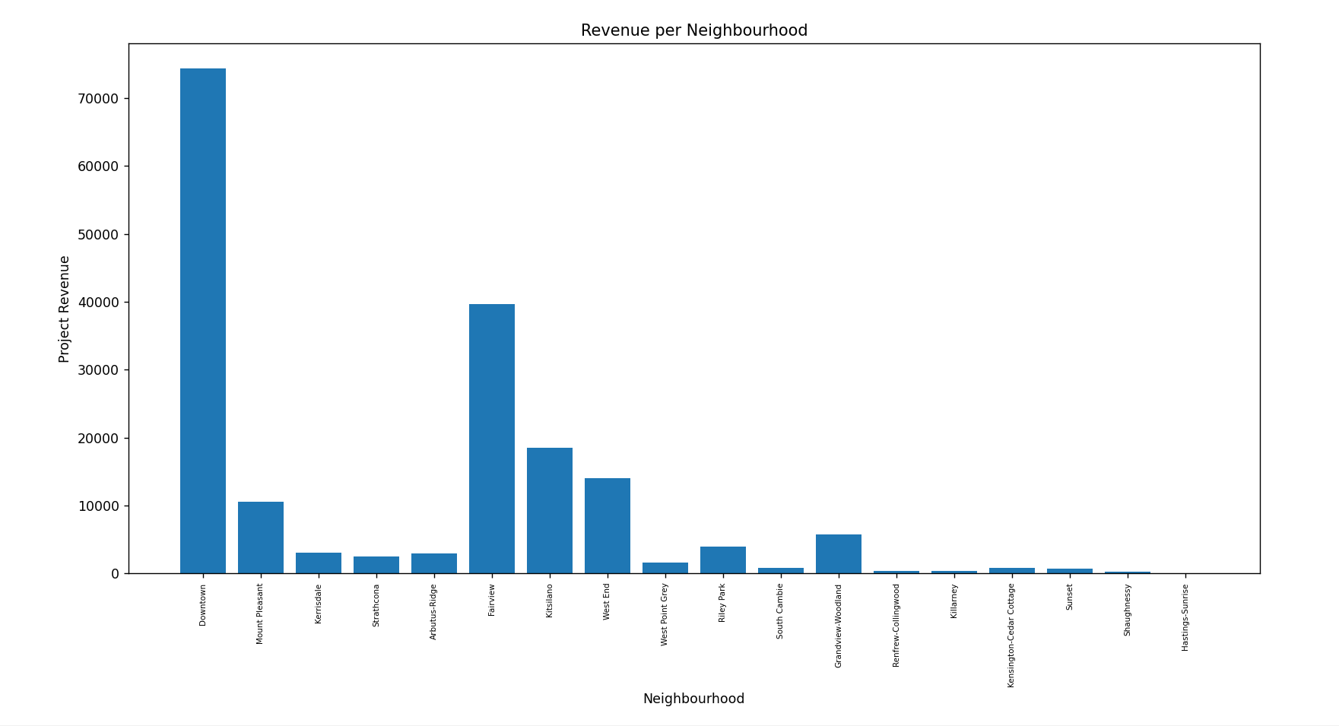
Potential Revenue by Neighbourhood
Notes:
(Owen)
Day time of weekdays. Here is the bar graph that we would generate from the last function revenue. Here we could tell that downtown would generate the most amount, which would make most sense as it has the highest median with the most parking spots.

Slide 11
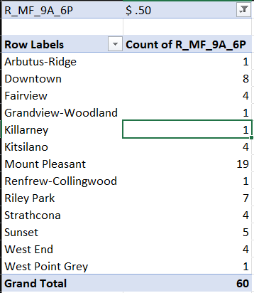
Excel Pivot Chart: Filter on how many spots there is to part given a price
Notes:
(Owen)
In this chart, we are using a pivot chart in excel, where it say 50 cents, you are able to filter through the different price points to see how many spots there are in the neighbourhood with that dollar amount

Slide 12
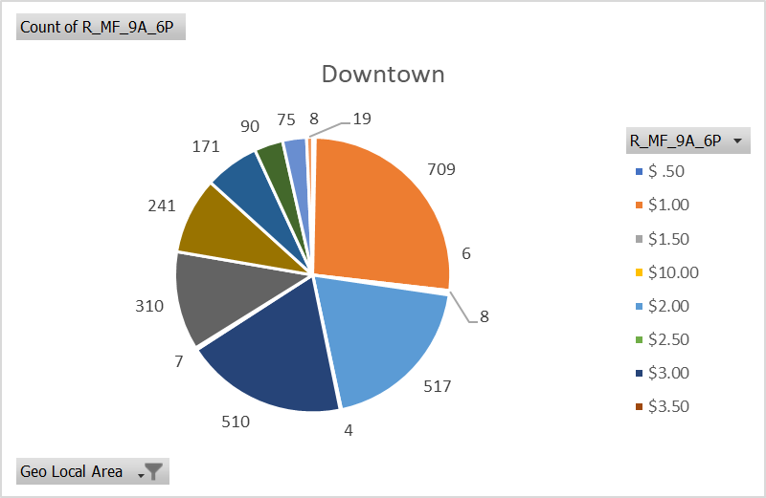
Notes:
(Owen)
Here is another pie chart that we had created from a pivot chart in excel where it shows the amount of parking spots at a given price point per a neighbourhood.

Slide 13
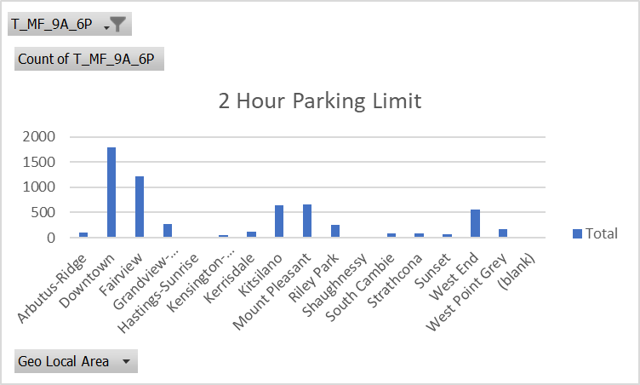
Notes:
(Owen)
In this chart shows the amount of spots that the city has per a time limit

Slide 14
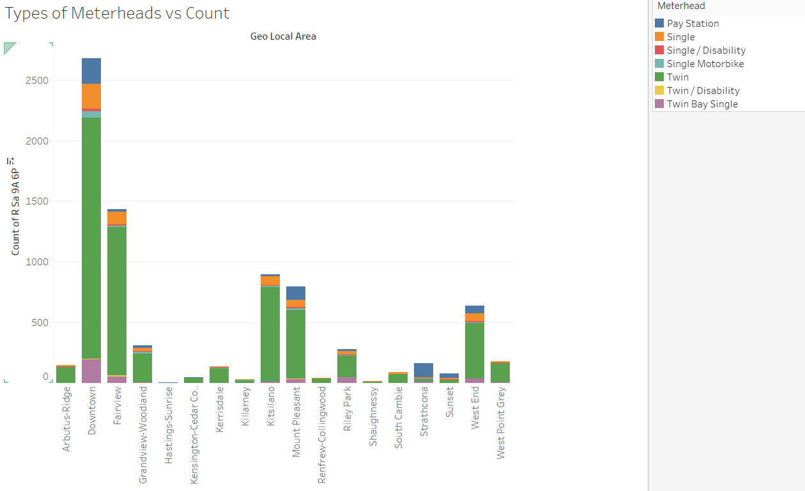
Notes:
(owen)
In this bar graph, we show the different types of meterheads that are in a given neighbourhood.
Although most cars can park anywhere, however this could be useful information as you would need to know where disability parking spots are because they would need bigger spot or where a motorcycle could park because those spots were generally cheaper

Slide 15
Regression
Owen is going to Vancouver and he is parking his car around 11am. He needs to park his car somewhere for roughly around 3 hours. How much would owen pay per hour to park for 3 hours?
Notes:
(Bradley)

Slide 16
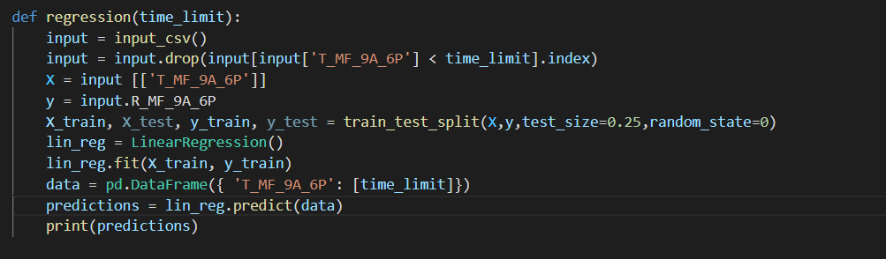
Prediction Code:
Notes:
(Owen)
In our code, we are calculating the regression line. As you can see in this function there is a time_limit variable, where we are looking for the time limit that is above 3 hours.
The drop method will take out any of the time limits that are below 3 hours, because they do not qualify for owen to park there and we do not want the AI to have the other part of the calculation.
X is the time limit that we are entering and the y output will be the amount that you will be spending per hour.
Data input is the time limit that you are staying, once it predicts it
The AI says that you be spending $2.11 per hour

Slide 17
Hypothesis Scenario
Using a sample size of 2675, the mean cost is $3.08 in downtown, Vancouver and the standard deviation of 1.983, test the claim (a = 0.05) that parking will exceed 3 or more dollars an hour when you park?
Notes:
(owen)
Using a sample size of 2675, the mean cost is $3.08 in downtown, Vancouver and the standard deviation of 1.983, test the claim (a = 0.05) that parking will exceed 3 or more dollars an hour when you park?Using a sample size of 2675, the mean cost is $3.08 in downtown, Vancouver and the standard deviation of 1.983, test the claim (a = 0.05) that parking will exceed 3 or more dollars an hour when you park?

Slide 18
Hypothesis Testing:
 | H0 True: Owen will have to pay 3 or more dollars | H0 False: Owen will have to pay under 3 dollars for parking
Reject H0: Where Owen will have to pay less than 3 dollars | Type I Error | Correct Decision
Do not reject H0: Where owen will have to pay 3 or more dollars | Correct Decision | Type II Error
Notes:
(Owen)
Ho would be true of owen would have to pay 3 or more dollars an hour to pay for parking
Ho false would mean that owen would have to pay under 3 dollars for parking

Slide 19

Hypothesis Testing for the Mean
x̄ = 3.08
m0= 3.00
s= 1.983
n= 2675
Notes:
(Bradley)
X-bar (Mean): 3.08
Mo = 3.00
S (Standard deviation) = 1.983
N (sample size) = 2675
Tdata value = 2.086

Slide 20
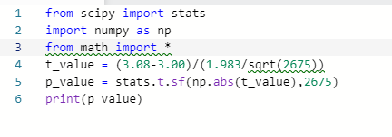

Hypothesis Testing
Since the value of p is 0.0185115 < 0.05 which will means that we would reject the null value and owen will pay less that 3 dollars
Notes:
(Bradley)
p(t < 2.086) = 1- 0.981511

Slide 21
Thanks for Listening
Questions?
Notes:
(Bradley)

